Slide 1
Digital Portfolio
STUDENT NAME: POOVARASAN.R
REGISTER NO AND NMID: EEE74CE4267DF3483804E64F4FBDA658/24131090500121009
DEPARTMENT: BACHELOR OF COMPUTER APPLICATION
COLLEGE: THIRUVALLUVAR ARTS AND SCIENCE COLLEGE/ANNAMALAI UNIVERSITY

Slide 2
PROJECT TITLE
TIMER

Slide 3


AGENDA
Problem Statement
Project Overview
End Users
Tools and Technologies
Portfolio design and Layout
Features and Functionality
Results and Screenshots
Conclusion
Github Link
3/21/2024 Annual Review

Slide 4

PROBLEM STATEMENT
People need simple digital tools for time management / task tracking.Traditional methods (paper, basic clocks) lack interactivity.Need a modern, responsive web-based solution.

Slide 5

PROJECT OVERVIEW
Developed a web application using HTML, CSS, and JavaScript.Lightweight, user-friendly, and runs in any browser.Responsive design (desktop & mobile friendly).

Slide 6

WHO ARE THE END USERS?
Students (task planning, study time tracking).Professionals (meetings, schedules).General users (daily usage, reminders, productivity).

Slide 7

TOOLS AND TECHNIQUES
Frontend: HTML5, CSS3, JavaScriptEditor: VS CodeVersion Control: GitHubOptional: Bootstrap / Tailwind (if used)

Slide 8
POTFOLIO DESIGN AND LAYOUT
Clean UI with minimal design.Modular structure: HTML (structure), CSS (design), JS (logic).Responsive elements with interactive buttons.
8

Slide 9
FEATURES AND FUNCTIONALITY
(Example: if To-Do List)Add, edit, delete tasksMark tasks as completedLocal Storage for persistenceResponsive layout(Example: if Digital Clock)Real-time digital clockDark/Light mode toggleSmooth animationsResponsive for mobile & desktop

Slide 10
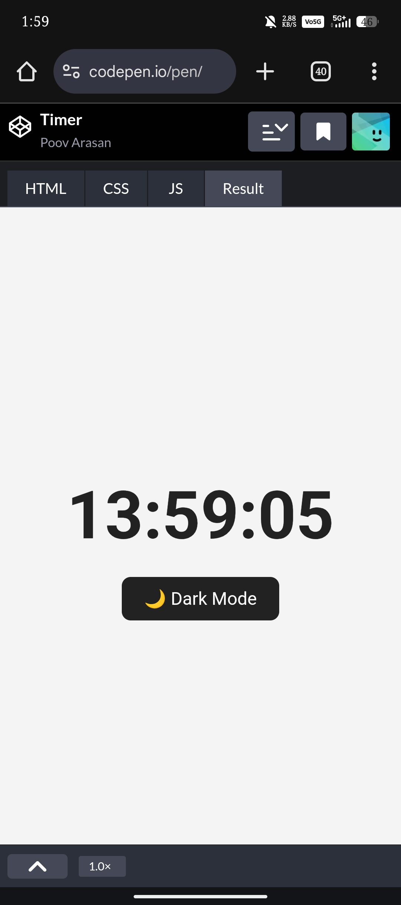

RESULTS AND SCREENSHOTS
3/21/2024 Annual Review
10

Slide 11
CONCLUSION
Project demonstrates practical use of HTML, CSS, JS.Simple, efficient, and user-friendly design.Can be extended with extra features (alarms, notifications, cloud sync, etc.).
11

